Slide 1
Capstone Project On Customer Account Tracker By Malreddy Sai Prasad Reddy MR00934292@TechMahindra.com

Slide 2
Objective
To create a Spring Boot application for manipulating and tracking the customer bank account data, by using MySQL database, based on client requirement.
Client Requirements:
Able to fetch account details with one click.
To grant access to customers, allowing them to edit their personal details.
Allowing customers to make transactions, deposit, withdrawals.
Storing all the customer transaction history in the database.
All repositories will extend CrudRepository.

Slide 3
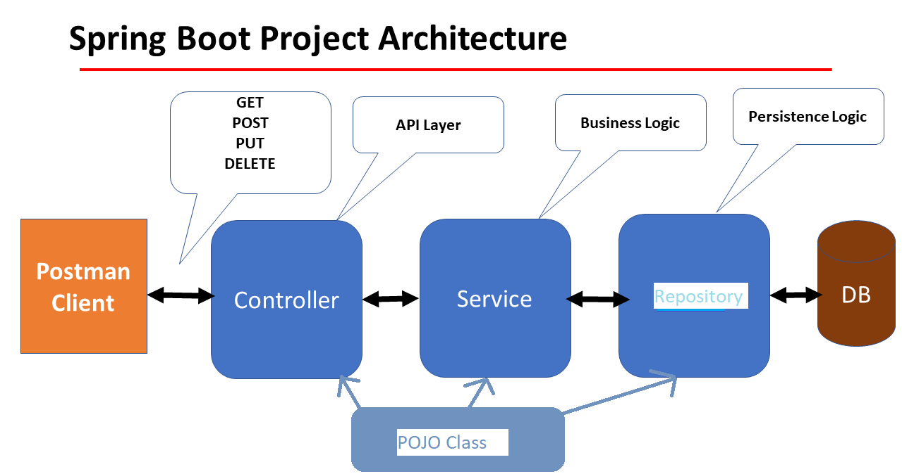
Implementation

Slide 4
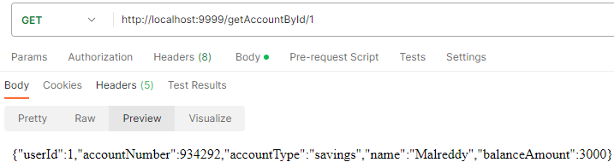
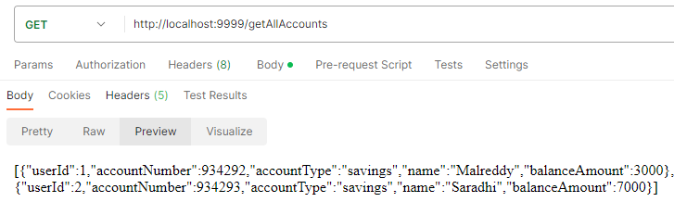
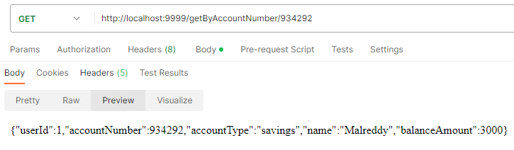
Requirement -1 : Account details Fetching.
Fetching single Account: output
Account Service: Fetching account details. (GET)
Fetching single Account: http://localhost:9999/getAccountById/{id}
Fetching All Accounts: http://localhost:9999/getAllAccounts
Fetching by Account Number: http://localhost:9999/getByAccountNumber/{accountNumber}
Fetching All Accounts: output
Fetching by Account Number: output

Slide 5
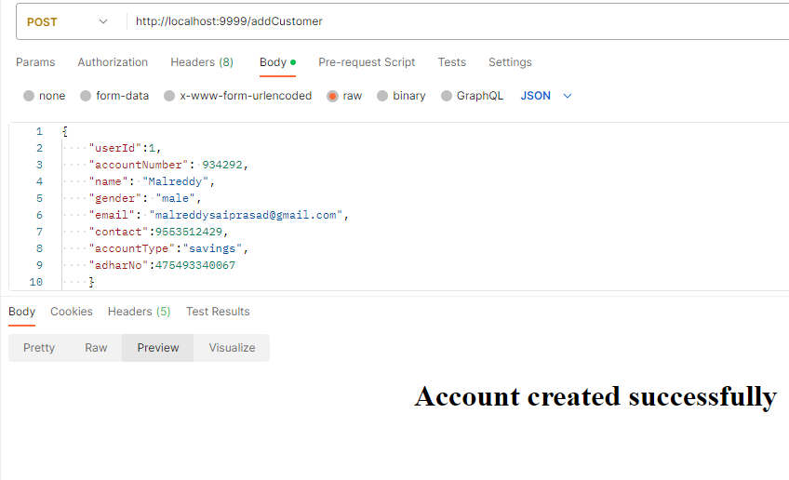
Requirement 2: CRUD operations on
Customer personal details
CRUD
Create account: (POST) http://localhost:9999/addCustomer
{
"userId":1,
"accountNumber": 934292,
"name": "Malreddy",
"gender": "male",
"email": "malreddysaiprasad@gmail.com",
"contact":9553512429,
"accountType": "savings",
"adharNo": 475493340067
}

Slide 6
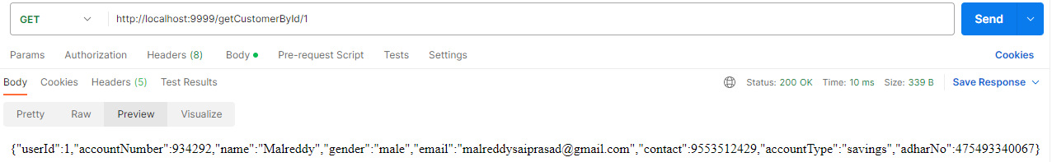
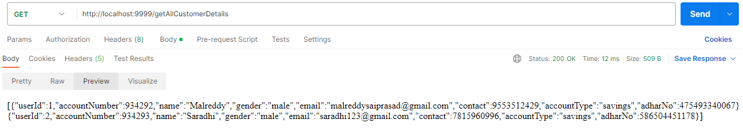
Requirement 2: CRUD operations on
Customer personal details
CRUD
Retrieve/Fetch Customer details: (GET)
By Id: http://localhost:9999/getCustomerById/{id}
○ All Customers: http://localhost:9999/getAllCustomerDetails

Slide 7
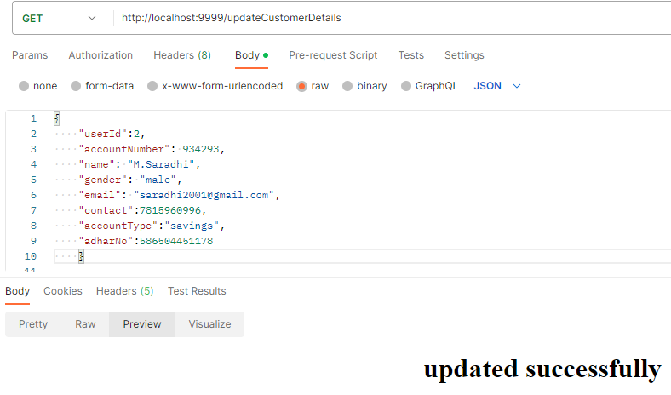
Requirement 2: CRUD operations on
Customer personal details
CRUD
Update Customer details: (GET)
http://localhost:9999/updateCustomerDetails
{
"userId":2,
"accountNumber": 934293,
"name": "M.Saradhi",
"gender": "male",
"email": "saradhi123@gmail.com",
"contact":7815960996,
"accountType":"savings",
"adharNo":586504451178
}

Slide 8
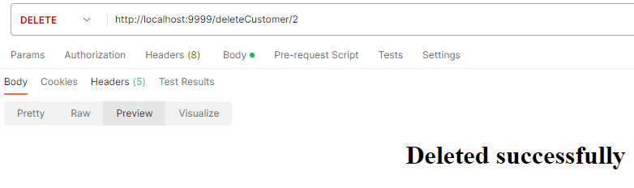
Requirement 2: CRUD operations on
Customer personal details
CRUD
Delete Customer Account: (DELETE)
By Id: http://localhost:9999/deleteCustomer/{id}

Slide 9
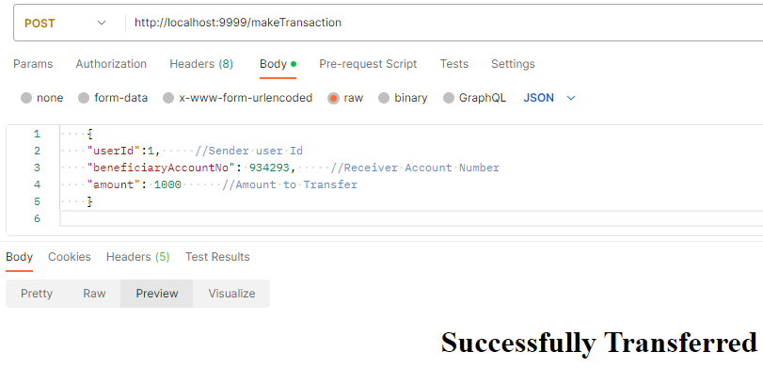
Requirement 3: To make Transactions,
Deposits, Withdrawals.
Transactions : From user 1 to user 2 (If enough funds exists).(POST)
http://localhost:9999/makeTransaction
{
"userId":1,
//Sender user Id
"beneficiaryAccountNo": 934293,
//Receiver Account Number
"amount": 1000
//Amount to Transfer
}

Slide 10
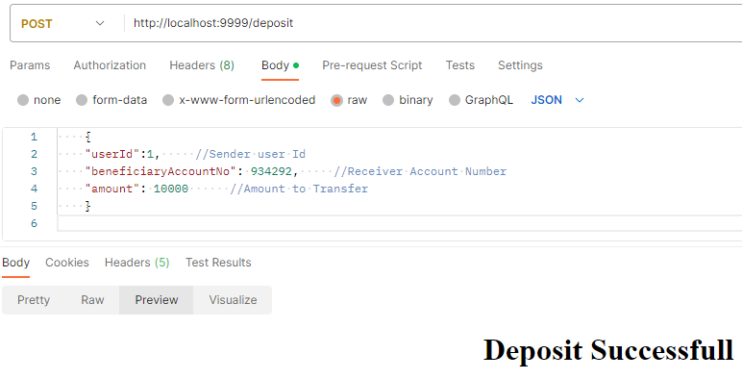
Requirement 3: To make Transactions,
Deposits, Withdrawals.
Deposits: (POST) http://localhost:9999/deposit
{
"userId":2,
//Self user Id
"beneficiaryAccountNo": 934293,
//Self Account Number
"amount": 10000
//Amount to Deposit
}

Slide 11
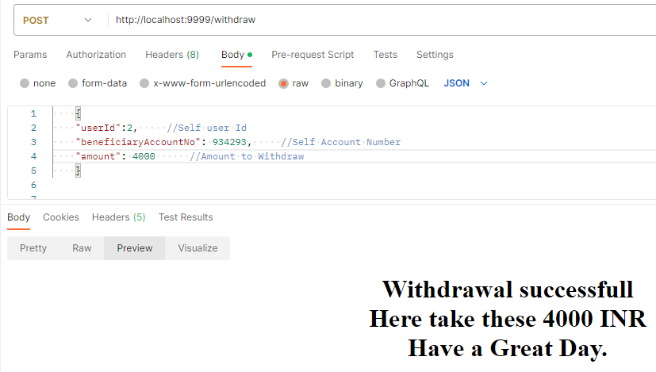
Requirement 3: To make Transactions,
Deposits, Withdrawals.
Withdrawal: (POST) http://localhost:9999/withdraw
{
"userId":2,
//Self user Id
"beneficiaryAccountNo": 934293,
//Self Account Number
"amount": 4000
//Amount to Withdraw
}

Slide 12
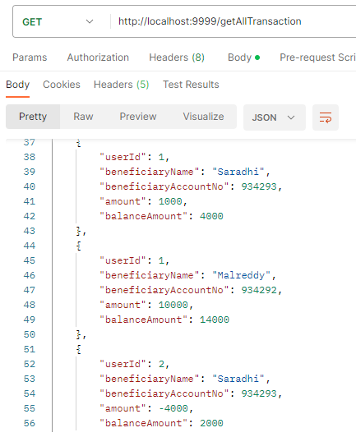
Requirement 4: Store all Transactions history
into the database.
Transaction History: All the transactions, deposits, and withdrawal history of customers will be stored in a separate database when they make a transaction.

Slide 13
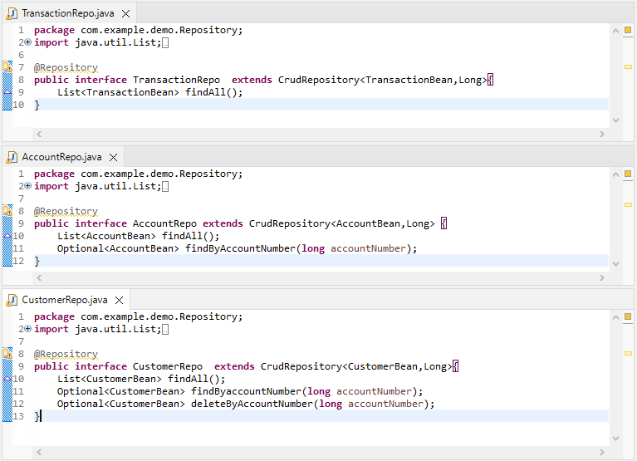
Requirement 5: All repositories will extend CrudRepository

Slide 14
Key Functionalities: based on above
Implementations.
Technologies used for above implementations.
Able to create accounts and can update customer personal details.
Able to fetch customer account details for client requirements.
Able to make transactions from one bank account to another bank account (if enough funds exists).
Able to deposit/withdraw money from their personal account.
All the data will be stored and can be fetched from the database (MySQL) in Realtime.
Spring Boot.
Spring Data JPA.
Restful API design and development.
MySQL for data storage.
Maven for dependency management.

Slide 15
******Thank You****** By Malreddy Sai Prasad Reddy MR00934292@TechMahindra.com

